Slide 1
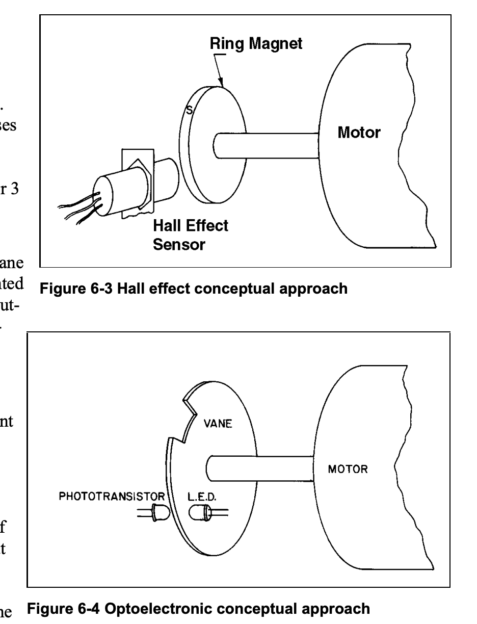
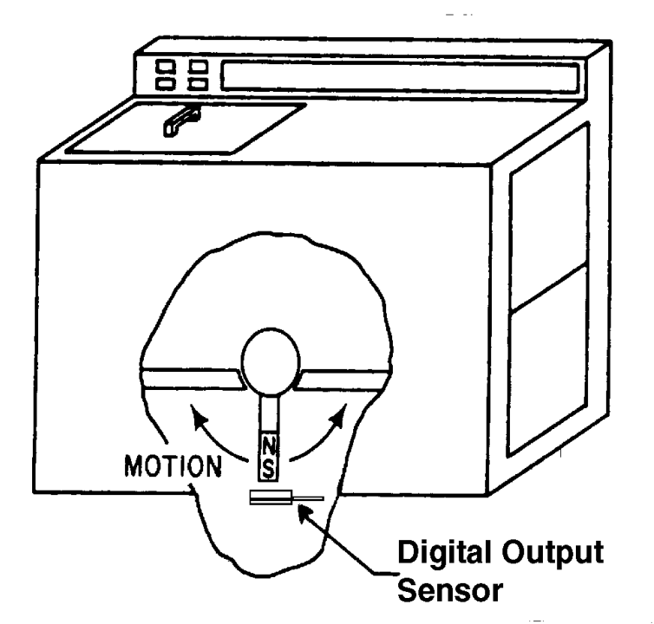
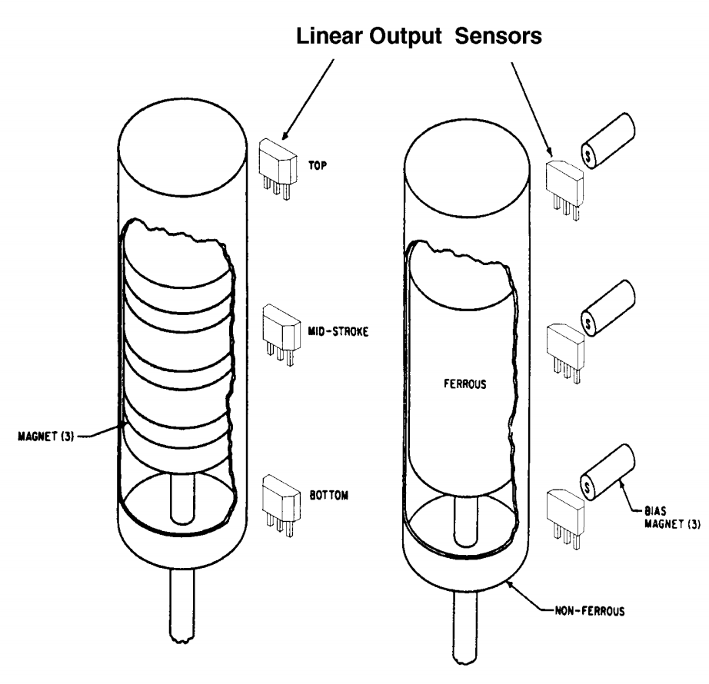
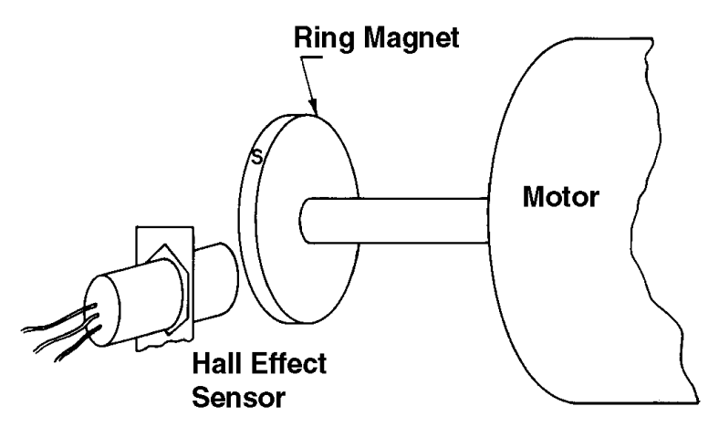
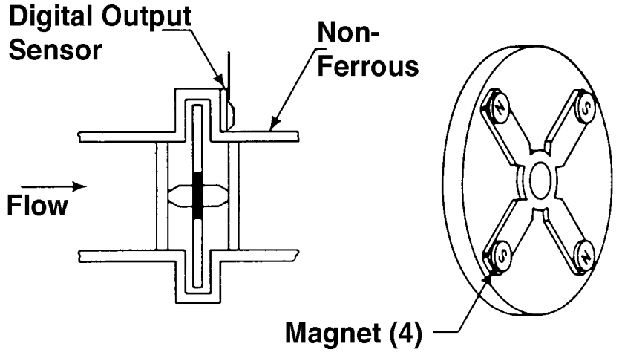
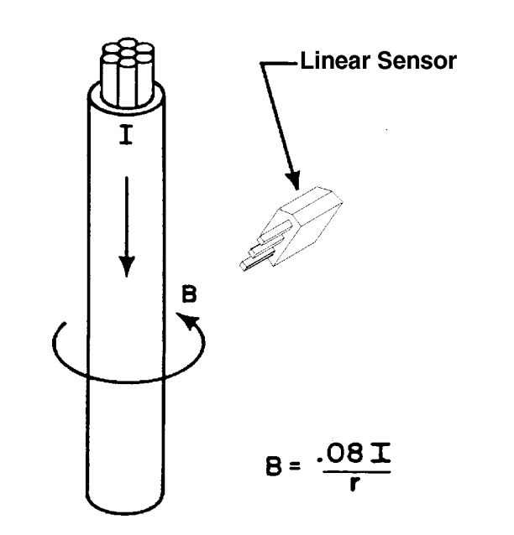
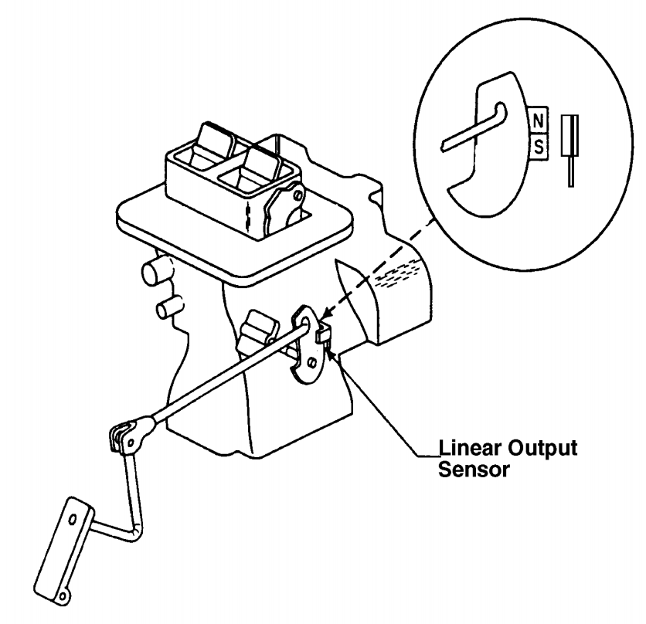
Level/title sensor
Tachometer (measure RPMs)
Piston detection
Flow meters
Current sensor
Throttle angle sensor
Notes:
From: https://sensing.honeywell.com/hallbook.pdf

Slide 2
Level/tilt sensor
Tachometer (measure RPMs)
Piston detection
Flow meters
Current sensor
Throttle angle sensor
Notes:
From: https://sensing.honeywell.com/hallbook.pdf

Slide 3
Level/tilt sensor
Tachometer (measure RPMs)
Piston detection
Flow meters
Current sensor
Throttle angle sensor
Notes:
From: https://sensing.honeywell.com/hallbook.pdf

Slide 4
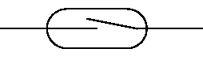
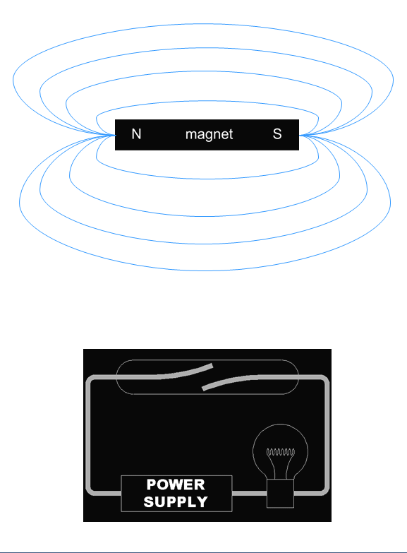
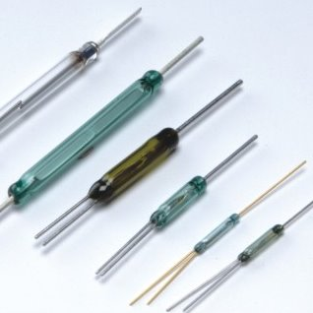
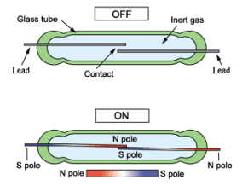
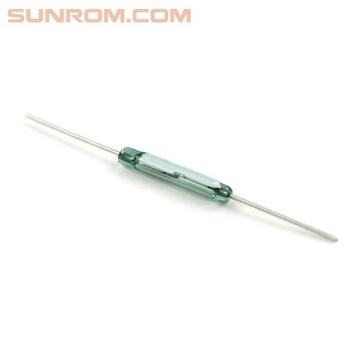
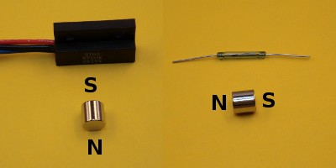

Reed Switch
An electrical switch operated by an applied magnetic field; it consists of a pair of contacts on ferrous metal reeds in a hermetically sealed glass envelope. The contacts close (or open) in the presence of a magnetic field
[source: http://www.sunrom.com/458; http://www.reed-switch-info.com/; http://en.wikipedia.org/wiki/Reed_switch]
Notes:
reed switch is an electrical switch operated by an applied magnetic field. It was invented at Bell Telephone Laboratories in 1936 by W. B. Ellwood. It consists of a pair of contacts on ferrous metal reeds in a hermetically sealed glass envelope. The contacts

Slide 5
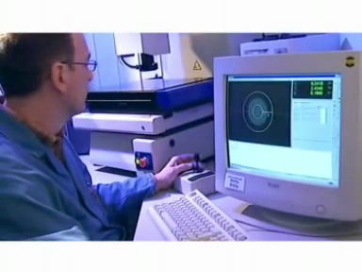
Reed Switch
[source: http://youtu.be/qje8LhZXwO0]
Notes:
http://youtu.be/qje8LhZXwO0

Slide 6
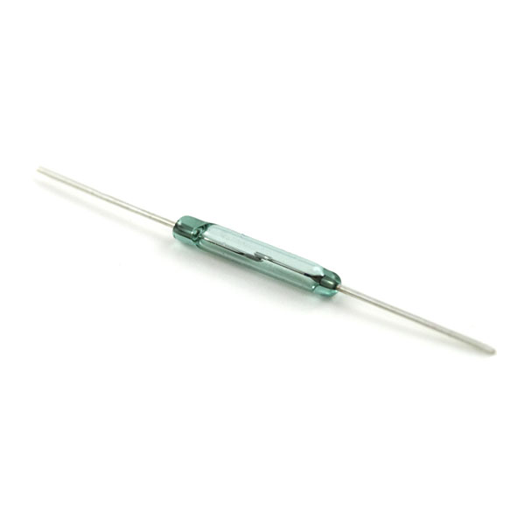
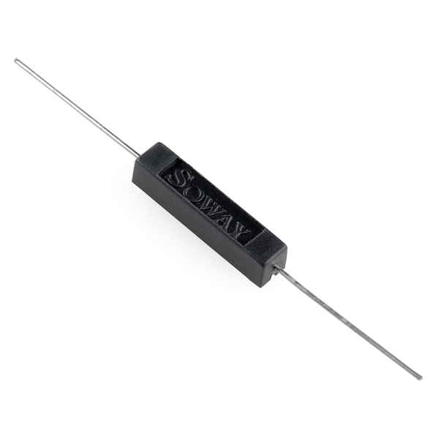
Reed Switch
Uninsulated Reed Switch: $1.50
Insulated Reed Switch: $1.95
https://www.sparkfun.com/products/8642
https://www.sparkfun.com/products/10601
[source: http://www.sunrom.com/458; http://www.reed-switch-info.com/; http://en.wikipedia.org/wiki/Reed_switch]
Notes:
reed switch is an electrical switch operated by an applied magnetic field. It was invented at Bell Telephone Laboratories in 1936 by W. B. Ellwood. It consists of a pair of contacts on ferrous metal reeds in a hermetically sealed glass envelope. The contacts

Slide 7
How are reed switches used?

Slide 8
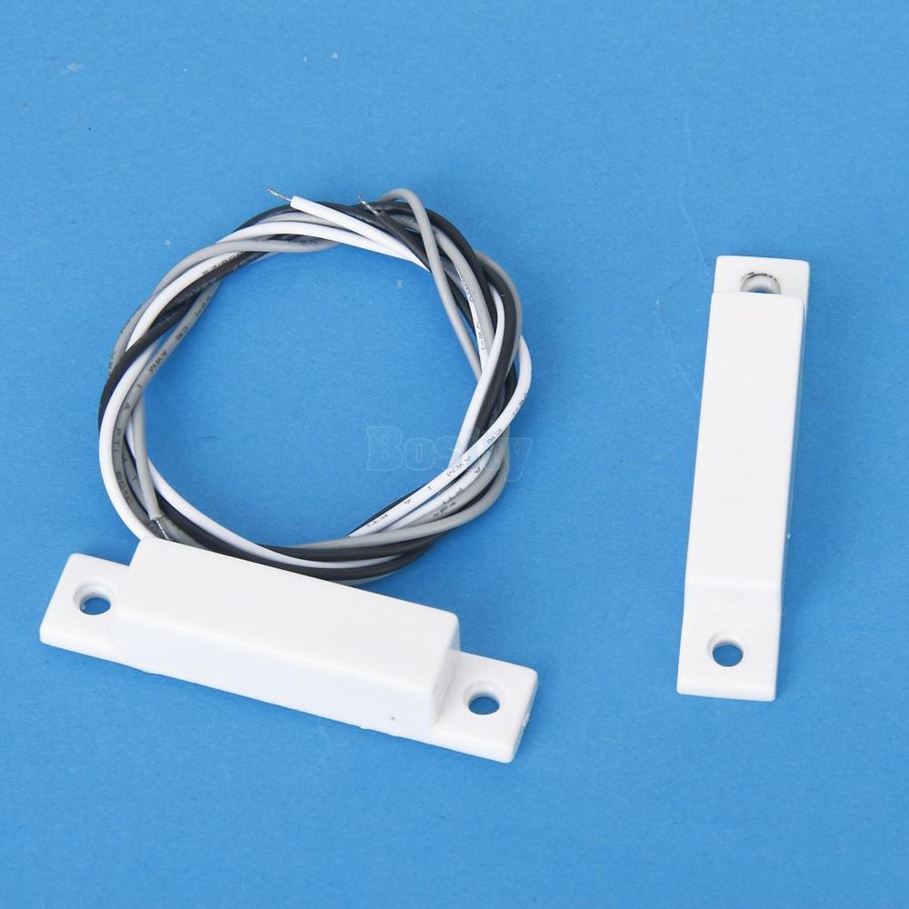

Slide 9
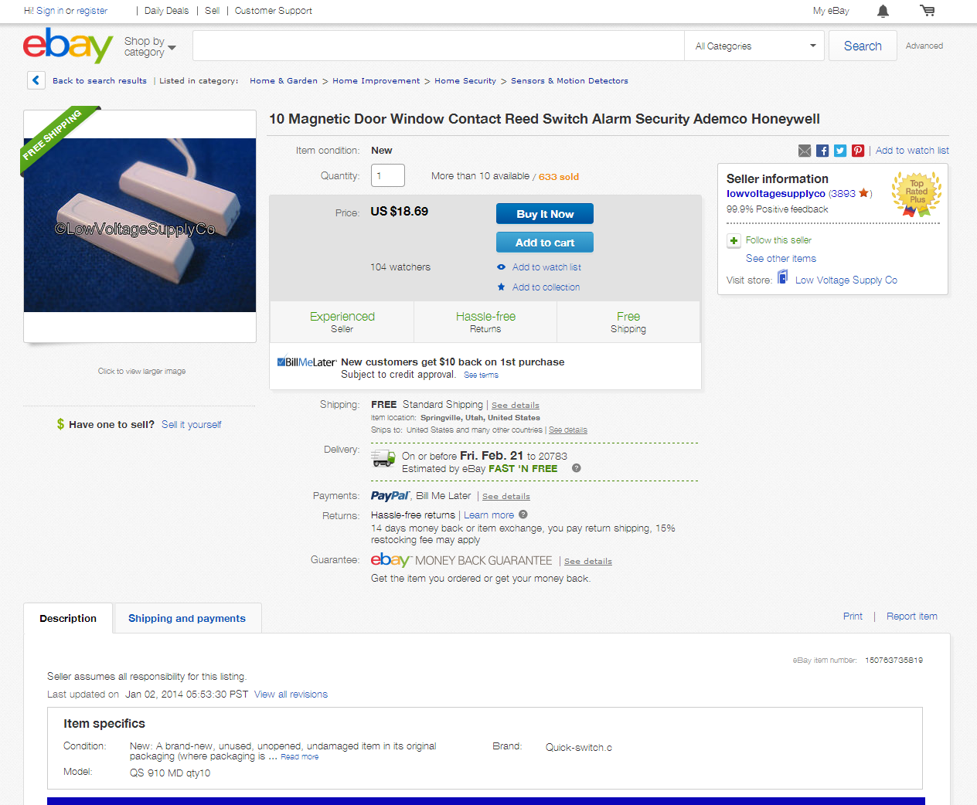

Slide 10
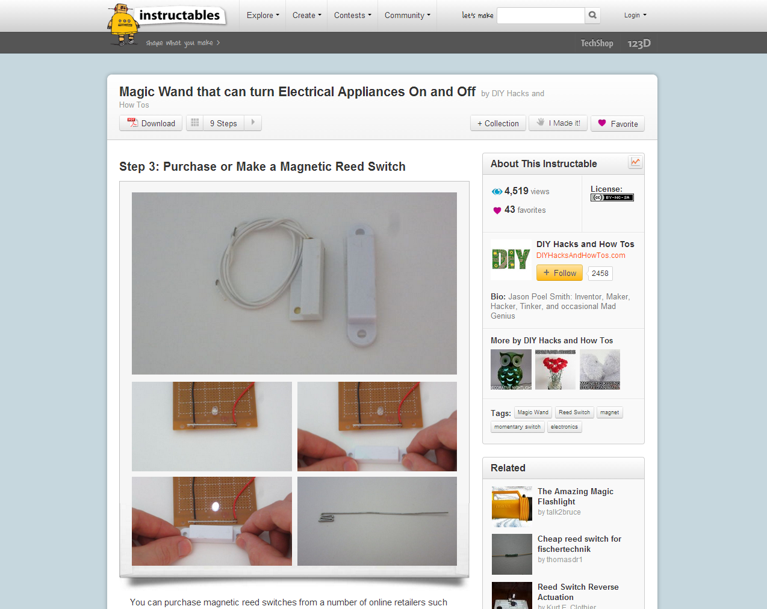
Notes:
http://www.instructables.com/id/Magic-Wand-that-can-turn-Electrical-Appliances-On-/step3/Purchase-or-Make-a-Magnetic-Reed-Switch/

Slide 11
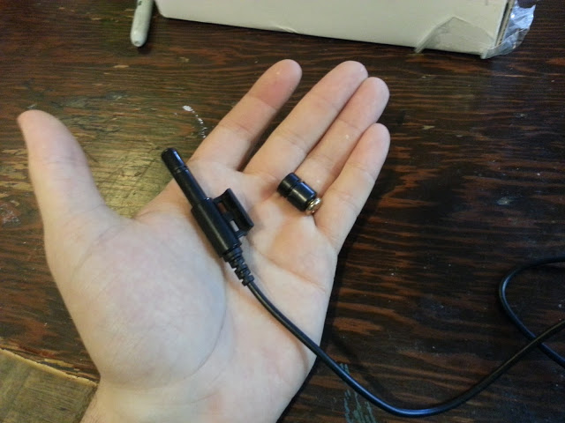
Notes:
http://yameb.blogspot.com/2013_07_01_archive.html

Slide 12
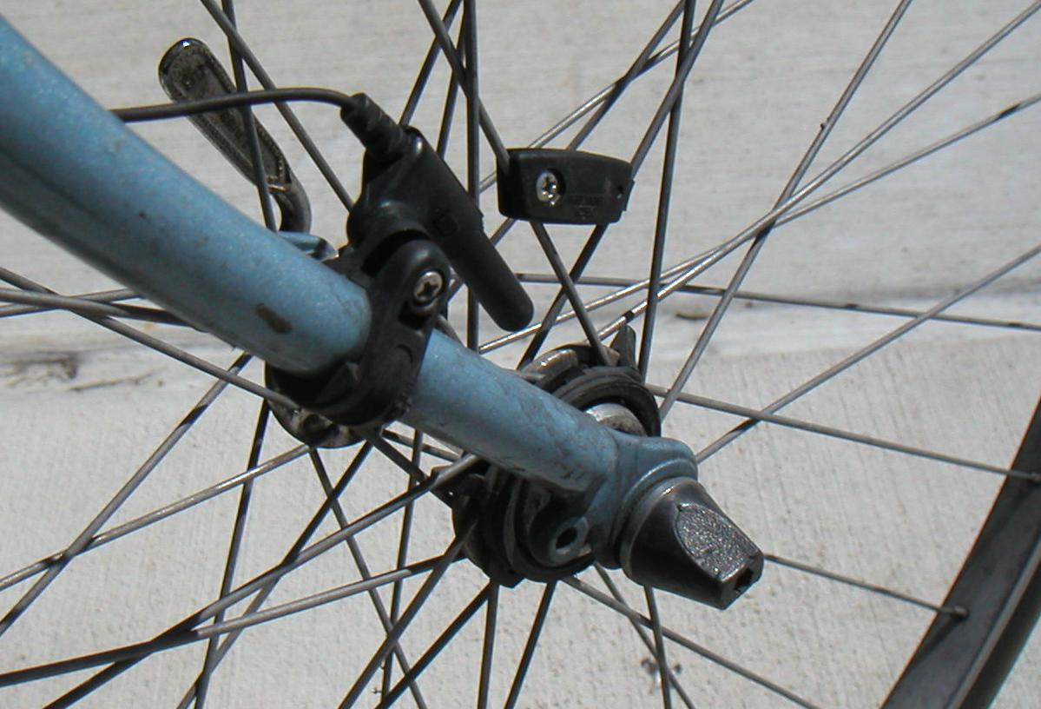
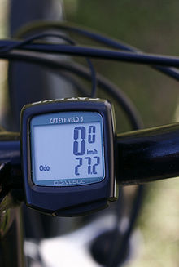
Notes:
http://upload.wikimedia.org/wikipedia/commons/3/3d/Cyclocomputer_sensor.JPG

Slide 13
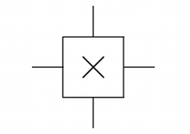
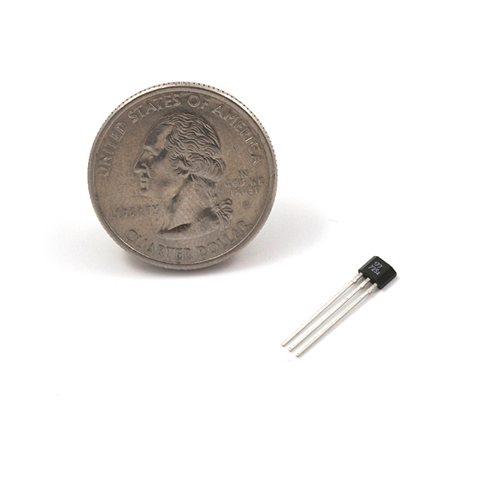
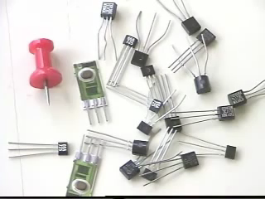
Hall Effect Sensor
A Hall effect sensor is a transducer that varies its output voltage in response to a magnetic field. Unlike the reed switch, no moving parts! Can be used for tracking position, speed, and proximity.
Hall Effect Sensor: $0.95
Three types: Hall Effect Switch, Hall Effect Latch, Hall Effect Ratiometric; http://youtu.be/9BFdGtvo9JE
https://www.sparkfun.com/products/9312
[source: http://www.sunrom.com/458; http://www.reed-switch-info.com/; http://en.wikipedia.org/wiki/Reed_switch]
Notes:
reed switch is an electrical switch operated by an applied magnetic field. It was invented at Bell Telephone Laboratories in 1936 by W. B. Ellwood. It consists of a pair of contacts on ferrous metal reeds in a hermetically sealed glass envelope. The contacts

Slide 14
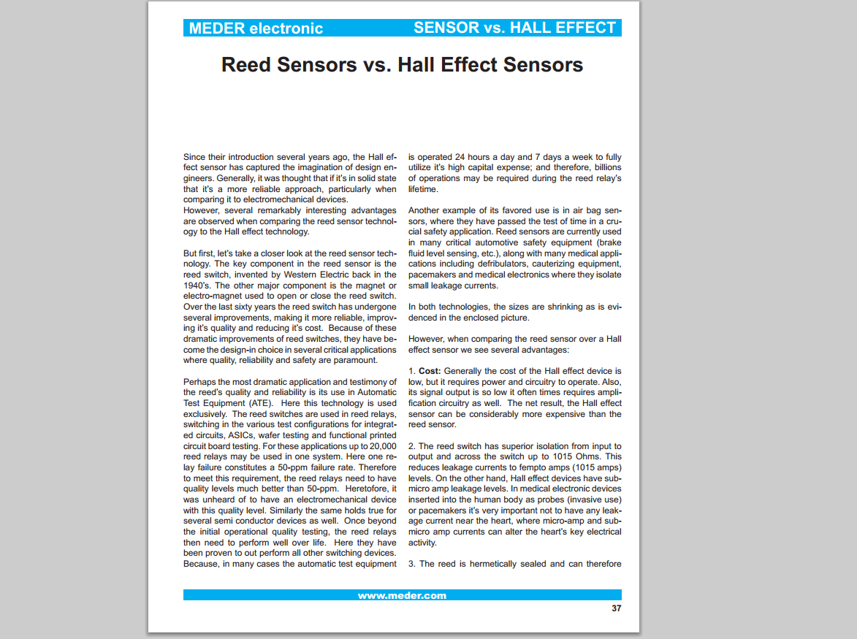
Reed vs. Hall Effect
Notes:
http://www.digikey.com/Web%20Export/Supplier%20Content/Meder_374/PDF/MEDER_Reed_Sensors_vs._Hall_Effect_Sensors.pdf?redirected=1

Slide 15
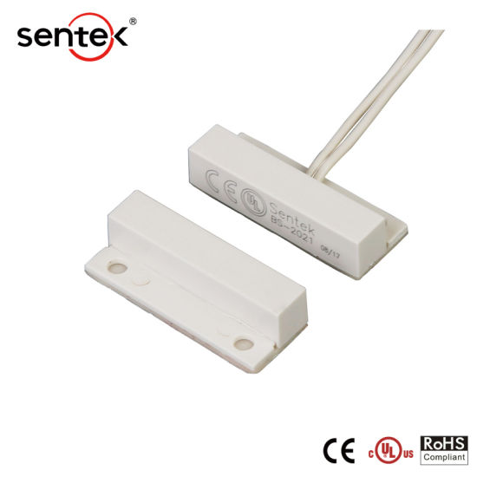
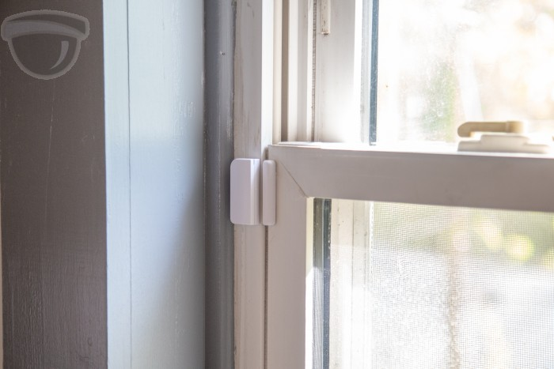
Notes:
Reed Switch
https://www.google.com/imgres?imgurl=https%3A%2F%2Fwww.reed-sensor.com%2Fwp-content%2Fuploads%2Fwindow_security.jpg&imgrefurl=https%3A%2F%2Fwww.reed-sensor.com%2Fapplications%2Fconstruction%2Fdoor-window-security%2F&tbnid=4THHaZOX2sluBM&vet=12ahUKEwiynfz10v7oAhWPh54KHSHLCnsQMygFegUIARCHAg..i&docid=JHZ7Pmmmt-WACM&w=256&h=256&q=reed%20switch%20on%20window&ved=2ahUKEwiynfz10v7oAhWPh54KHSHLCnsQMygFegUIARCHAg#h=256&imgdii=g6T0fP-9ZT_sWM:&vet=12ahUKEwiynfz10v7oAhWPh54KHSHLCnsQMygFegUIARCHAg..i&w=256

Slide 16
Hmm, actually not sure if magnetic poles can be switched for a reed switch..
Hall effect sensor
Reed switch
Hall effect sensor
Reed switch
S
N
N
S
S
N
N
S

Slide 17
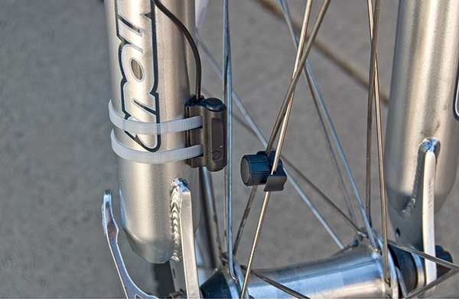
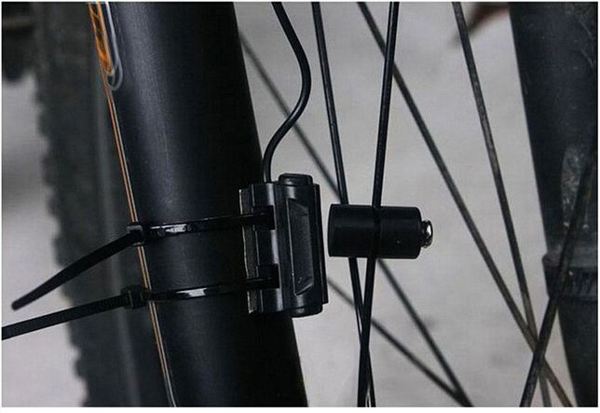
Hall effect sensor or reed switch
Hall effect sensor or reed switch
Magnet
Magnet

Slide 18
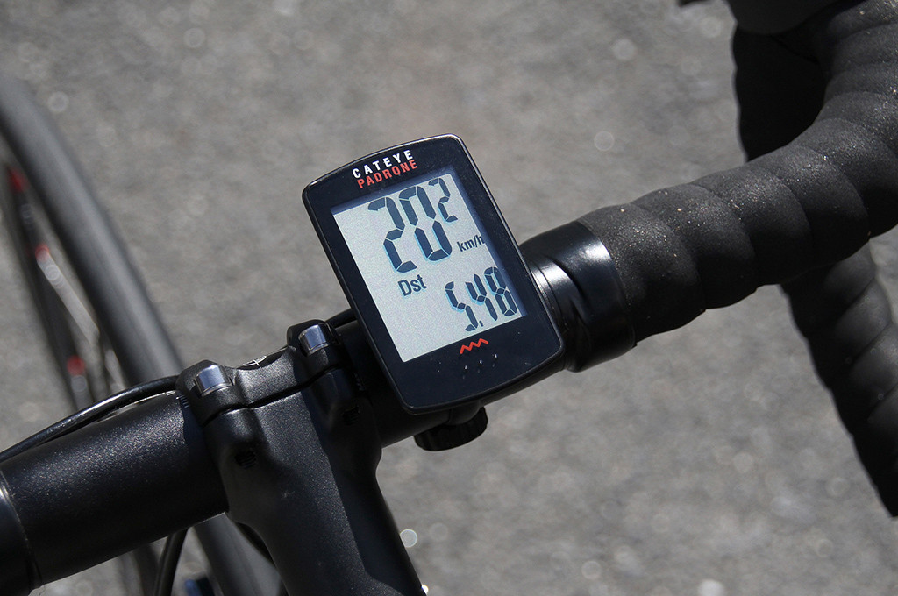
Hall effect sensor or reed switch
Hall effect sensor or reed switch
Magnet
Magnet

Slide 19

Notes:
https://www.youtube.com/watch?v=q-eGGDFeaUM

Slide 21
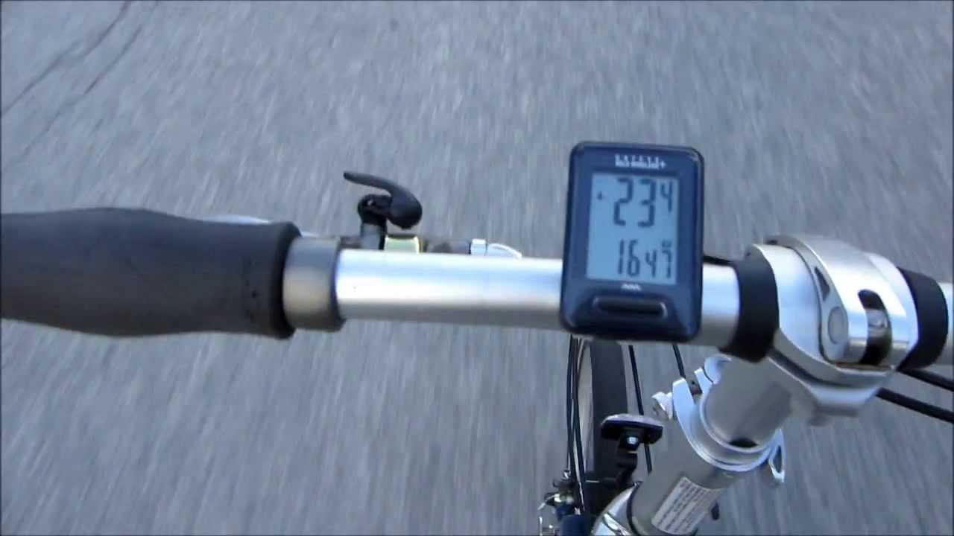

Slide 22
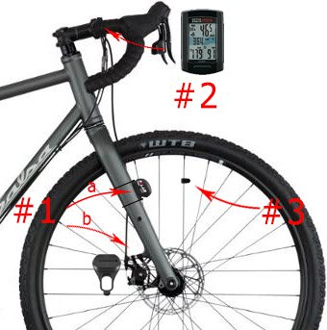

Slide 23
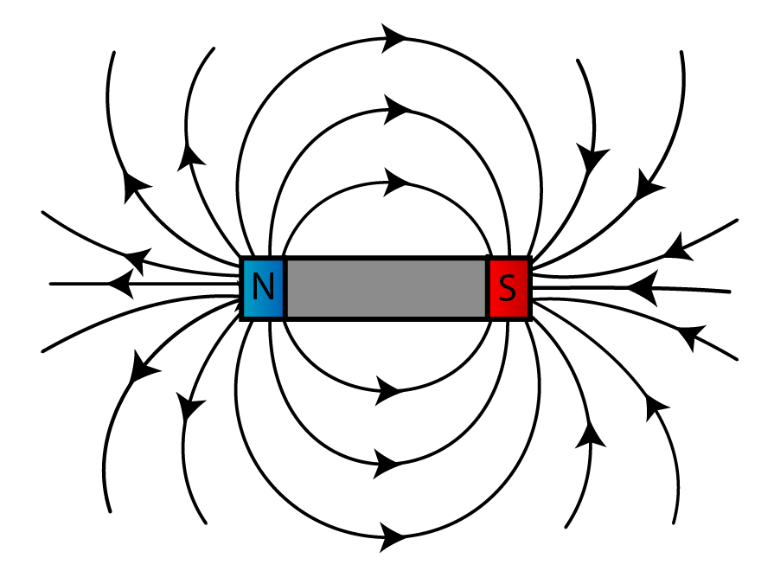
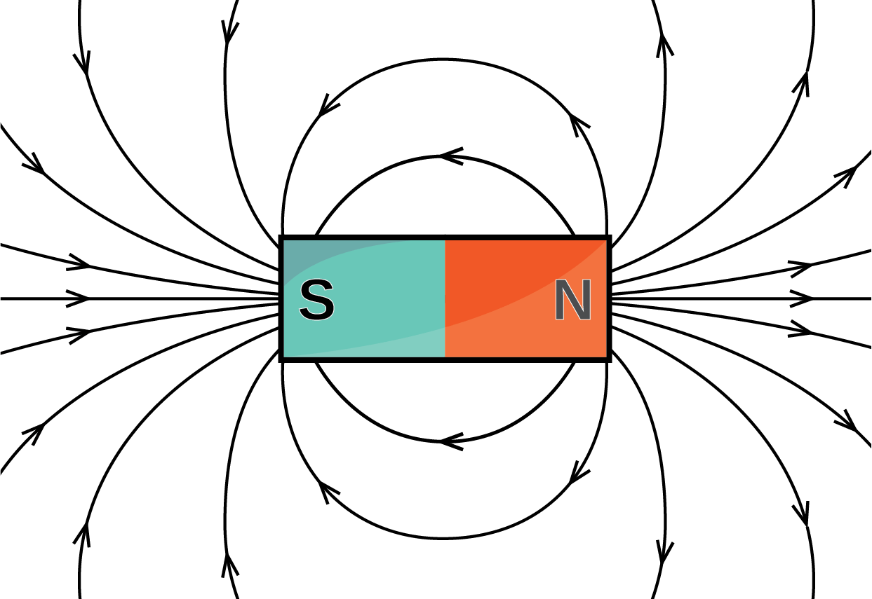
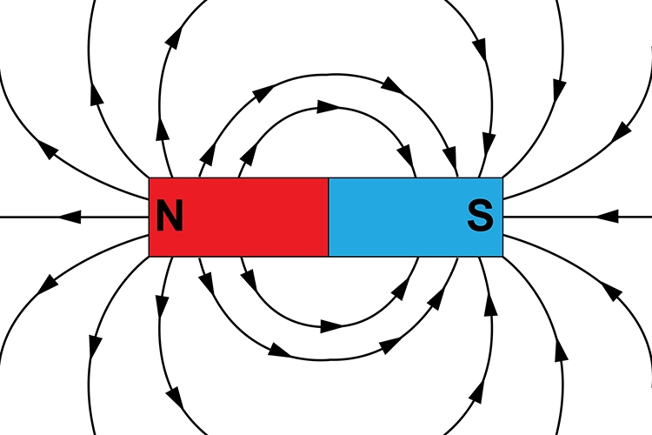

Slide 24
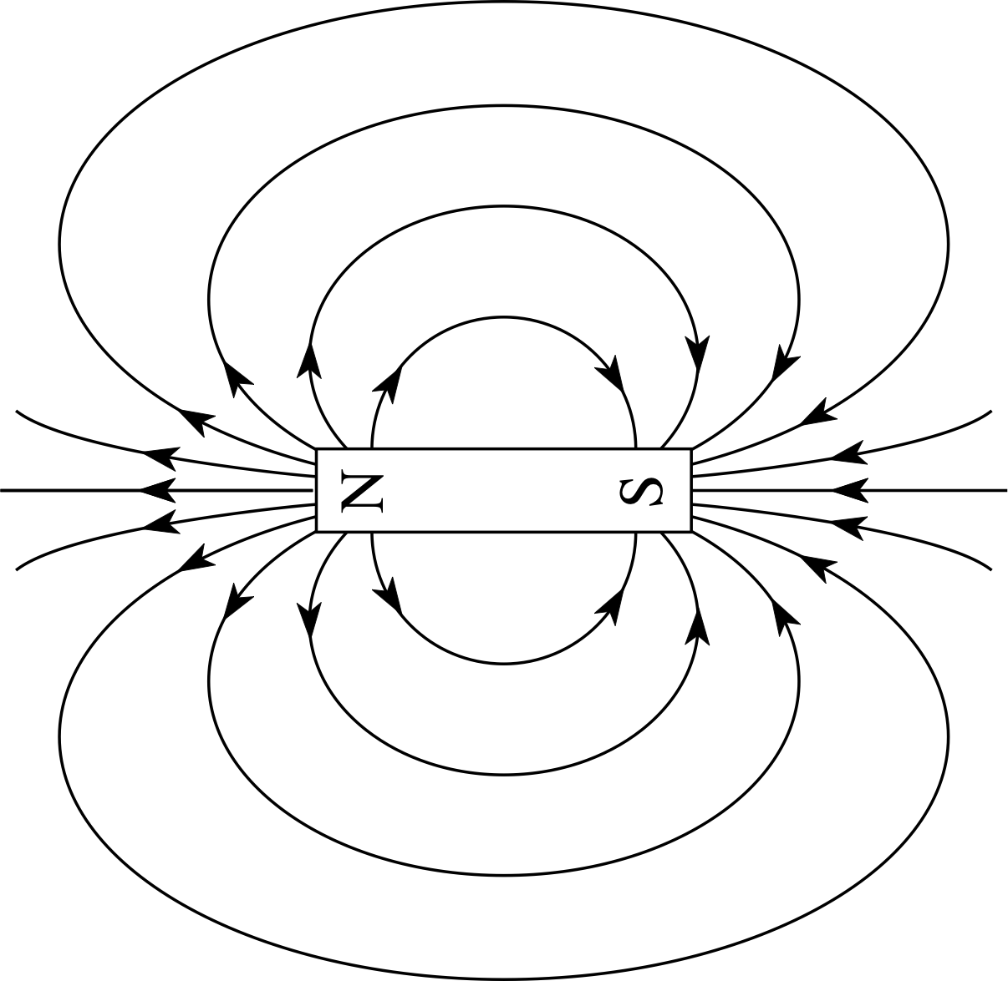

Slide 25
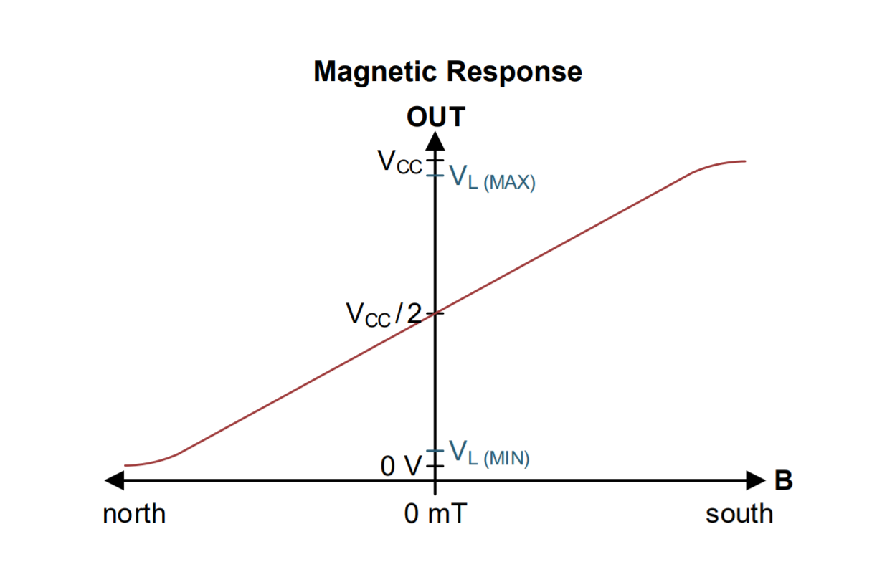
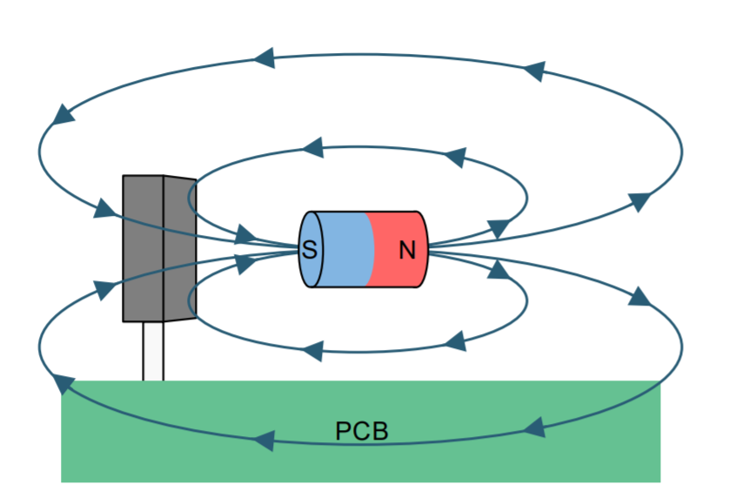
Notes:
http://www.ti.com/lit/ds/symlink/drv5055.pdf

Slide 26
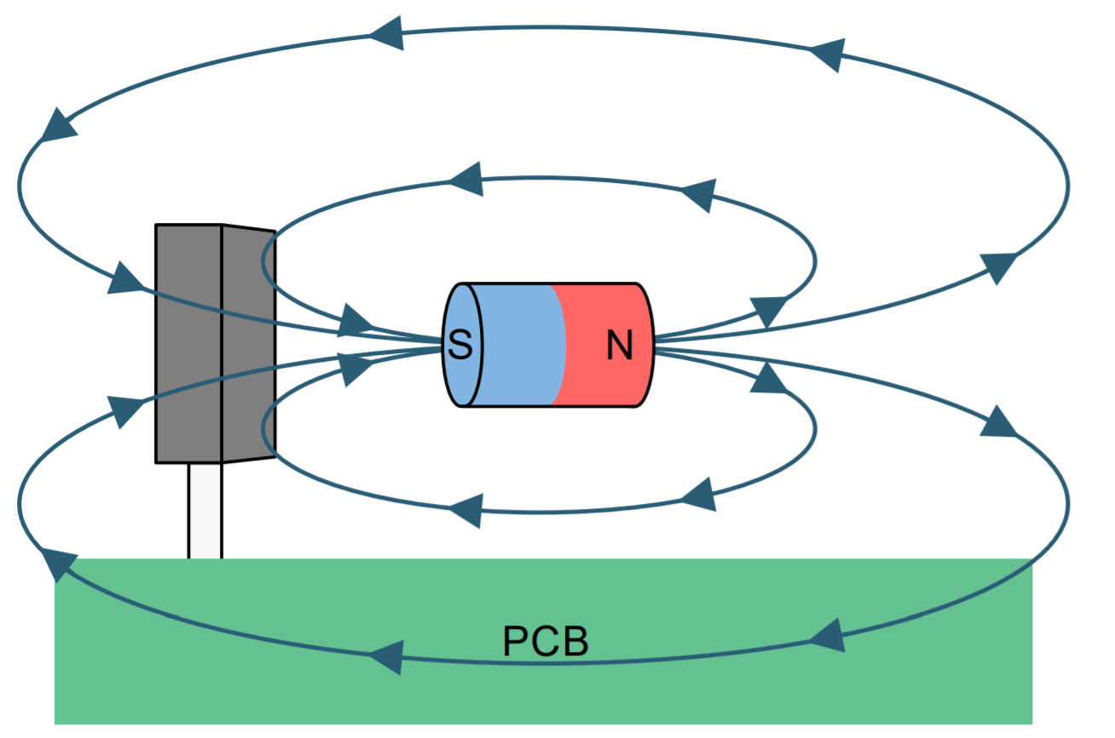
Hall effect
sensor
Notes:
http://www.ti.com/lit/ds/symlink/drv5055.pdf

Slide 27
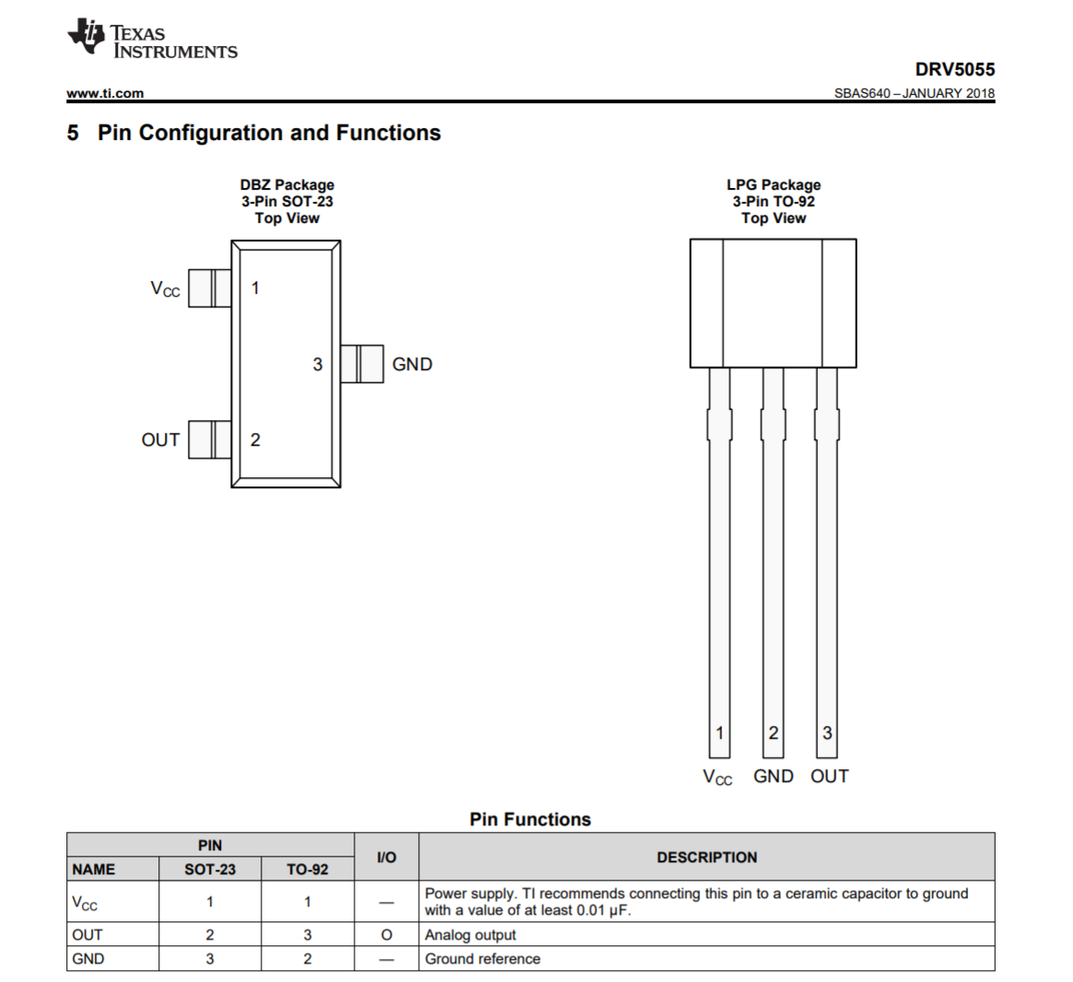

Slide 28
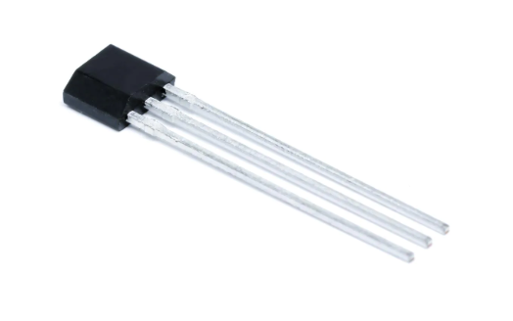
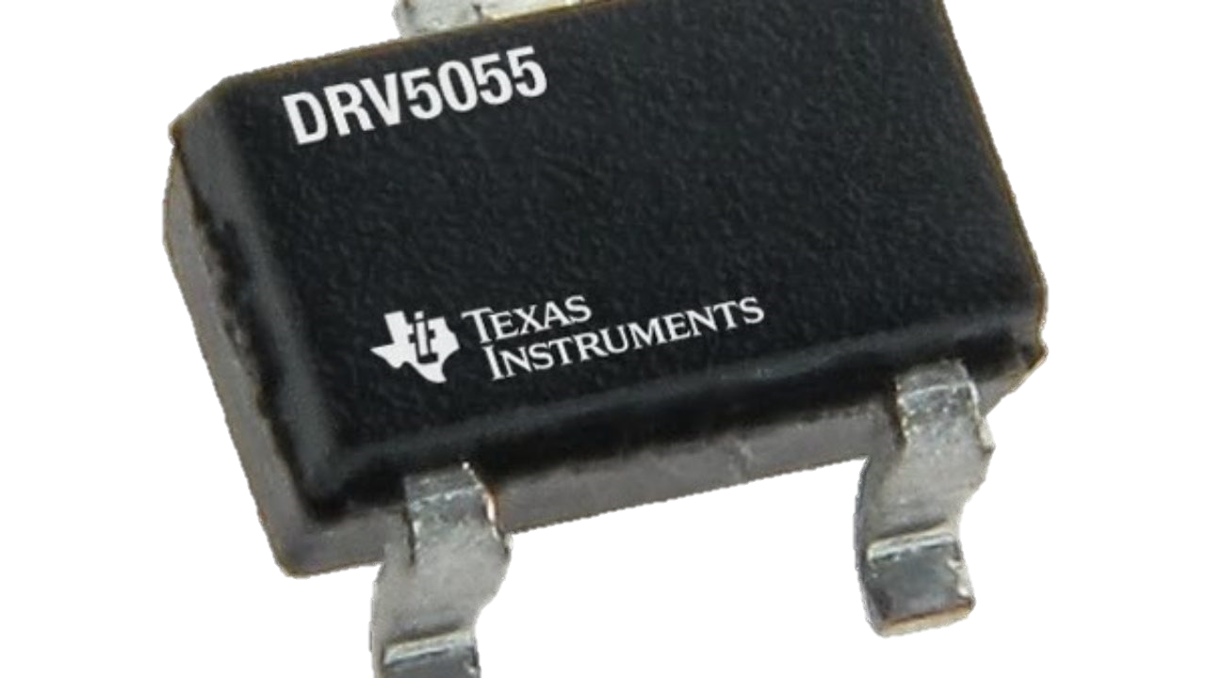
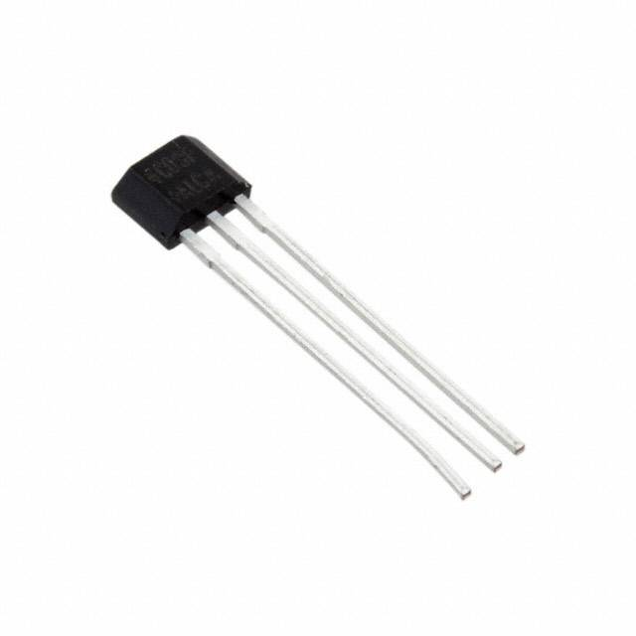
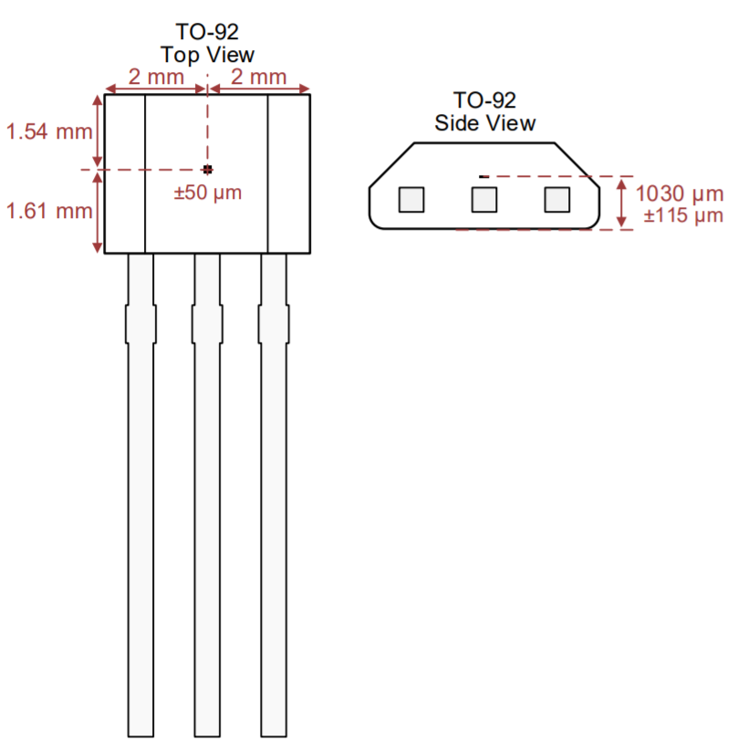
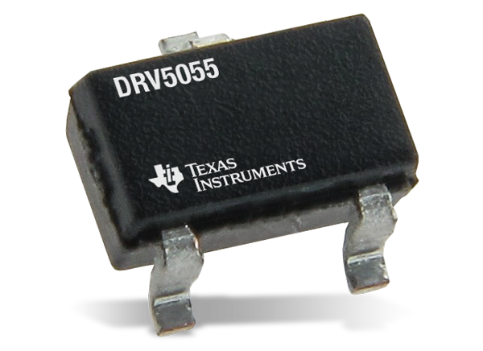
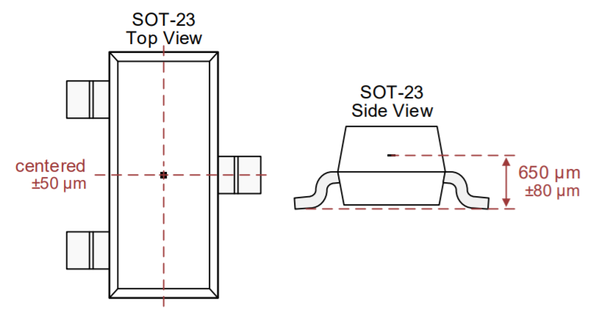
DRV5055 Surface Mount Package
DRV5055 Through hole Package
OUT
1
2
3
V_{cc}
GND

Slide 29
DRV5055 Surface Mount Package: S0t-23
DRV5055 Through hole Package: TO-92
3
GND
1
1
V_{cc}
3
2
GND
2
OUT
1
OUT
V_{cc}
Note that the pin configurations are different for the two packages. For the SOT-23, the OUT is Pin 2. For the TO-92, the OUT is Pin 3
1
2
1
3
2
3
V_{cc}
GND
V_{cc}
OUT
GND
OUT

Slide 30
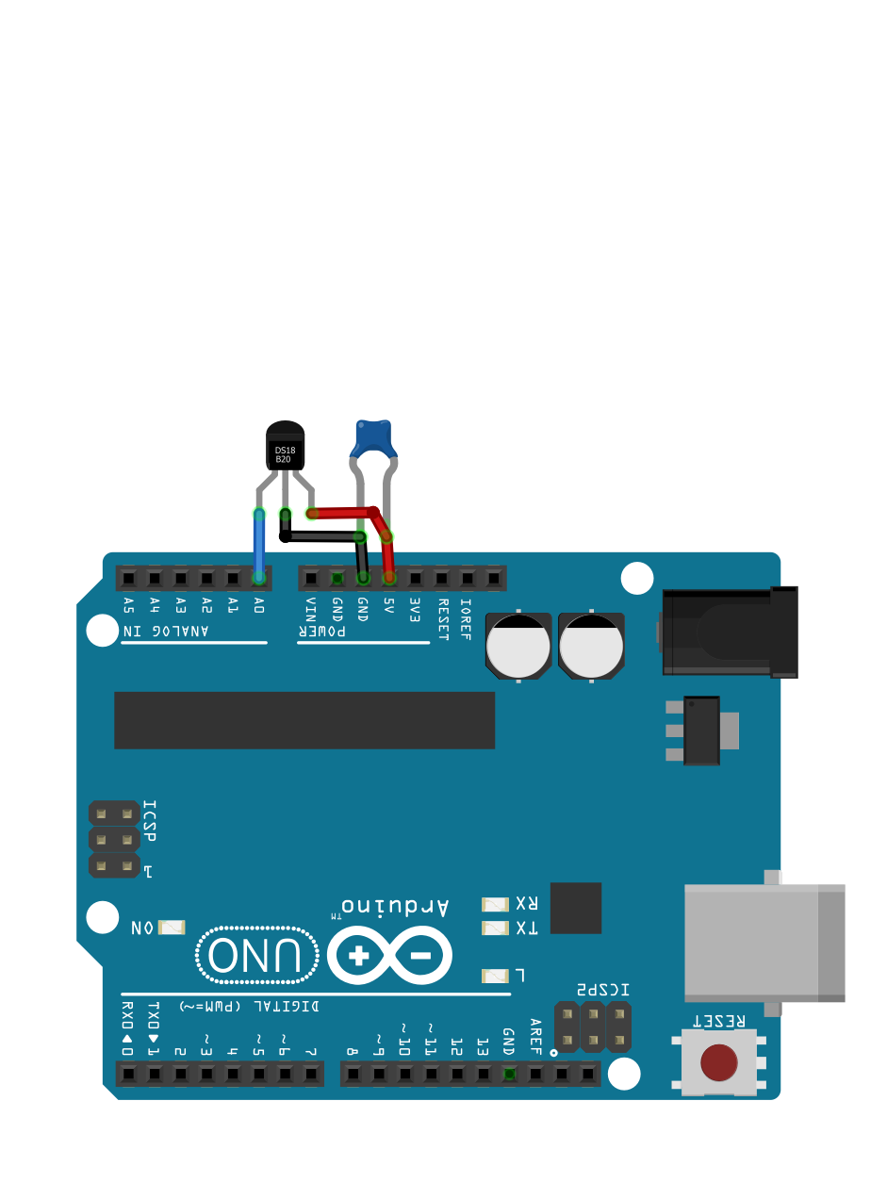
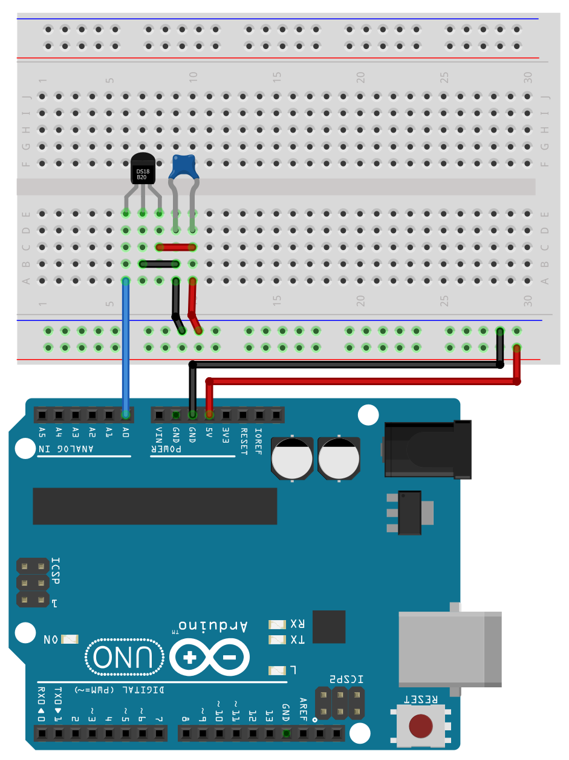
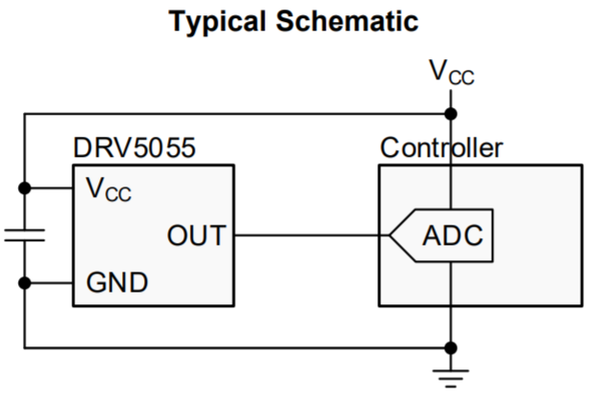
Recommended wiring with a 0.01 microfarad ceramic capacitor
The 0.01 µF capacitor is called a decoupling capacitor and will help smooth in the input supply (V_{cc})
Schematic copied directly from DRV5055 data sheet

